Slide 1

Week 4: Alternatives & Consequences Steps of PrOACT
Instructor: Brielle K Thompson
Course: NAT_R 8001 Decision Analysis for Research and Management of Natural Resources
Notes:
First 30 minutes = intro
Next 60 = slides
Final 30 = activity

Slide 2
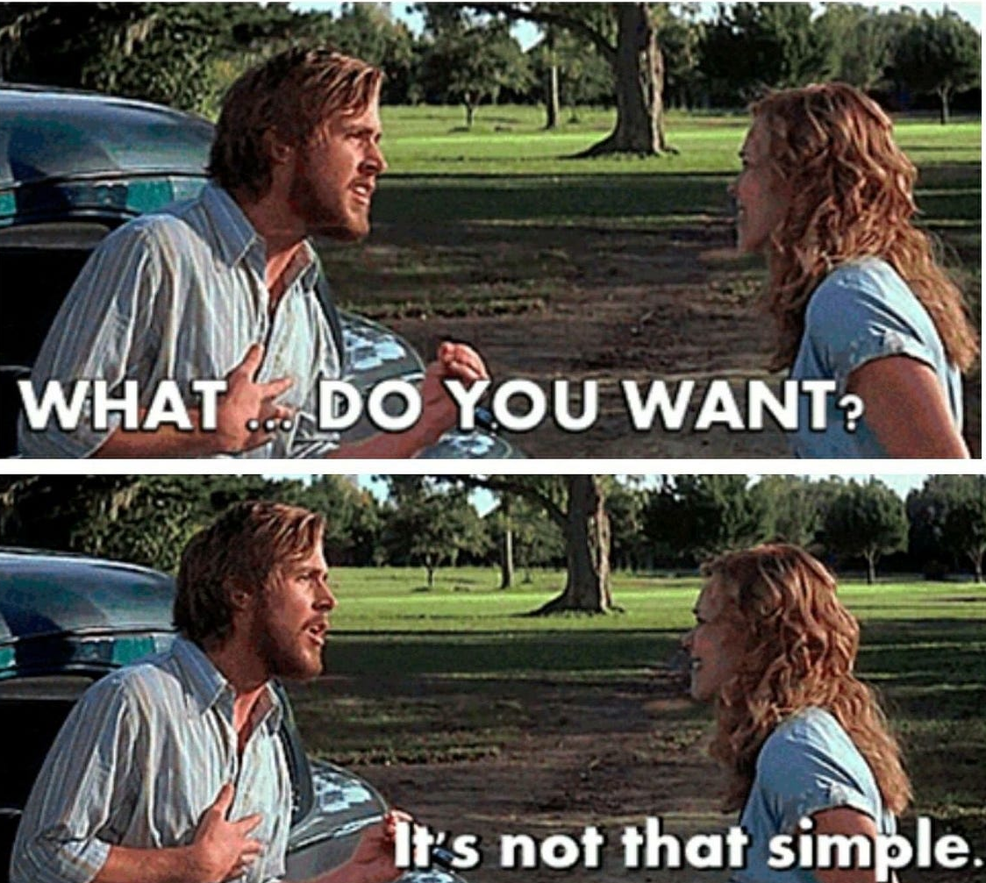
Review of last week
Discussed the Objectives step of SDM
Process for identifying objectives
Articulate goals & concerns
Convert goals & concerns to objectives
Structure objectives
3a. Classify and distinguish types of objectives
3b. Create an objectives hierarchy
Create measurable attributes for each objective
Repeat as needed
Pieces of an objective:
Direction + what is desired + attribute
(Maximize/ Minimize)
(Natural/ constructed/ proxy scale units)

Slide 3
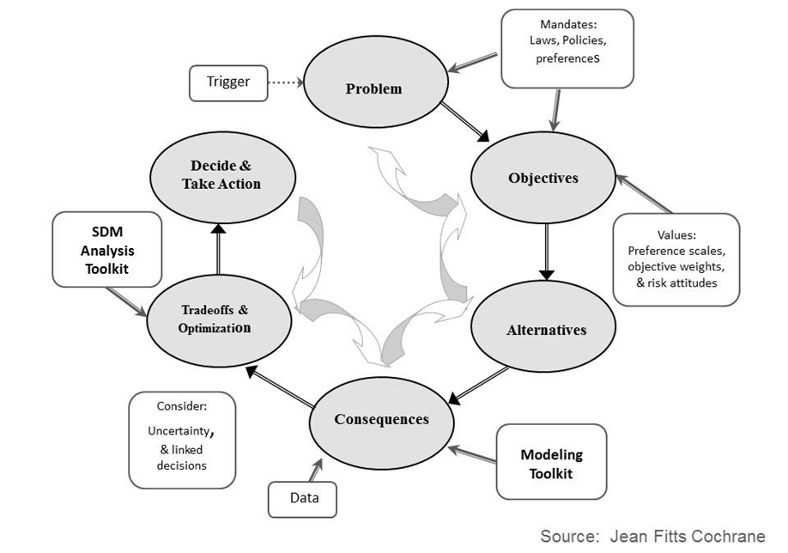
Today:
Learn about the Alternatives & Consequences step
1
2

Slide 4

What is an alternative?
Alternative (singular)
A potential solution to a decision problem
Alternatives (plural)
The set of potential solutions to a decision problem
Alternatives
Alternative A
Alternative C
Alternative B

Slide 5

Importance of good alternatives
Creative Commons Licenses photos
“The action selected will only be as good as the best alternative that is considered”
A good alternative is one that provides a good chance of achieving objectives
Good alternatives are:
Values-focused
Fully specified
Internally coherent
Distinct
Developed by Alex McInturff, Angela Matz, Mitch Eaton, Paul Barrett, Sarah J. Converse

Slide 6


Good alternatives require
Imagination
Beware of the tendency to limit our ideas to what are thought to be ‘practical’ alternatives
Creativity
Think of the widest range of possible alternatives
Don’t let preconceived ideas or constraints be limiting
To promote creativity – conduct a game:
Make group list 10 things they can do with [X = a pizza box, shoelace, etc.] and reward the most creative solution
Displate
Developed by Alex McInturff, Angela Matz, Mitch Eaton, Paul Barrett, Sarah J. Converse

Slide 7
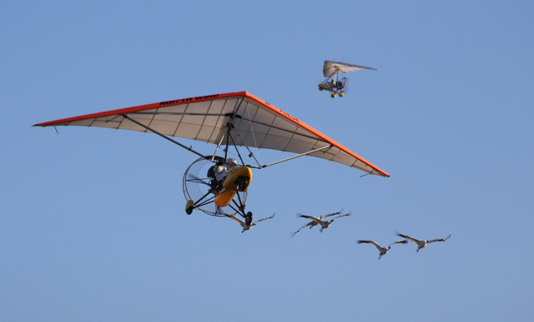
Creative Commons Licenses photos
Developed by Alex McInturff, Angela Matz, Mitch Eaton, Paul Barrett, Sarah J. Converse
Notes:
Fly away home example. An artist who worked on fly away home was invited to a usgs SDM consultation and inspired the use of using assisted migration for whooping craines

Slide 8

Challenges to identifying alternatives
Falling prey to cognitive biases (e.g., status quo bias)
Accepting real or perceived constraints
Evaluating alternatives prematurely
Tenor
Developed by Alex McInturff, Angela Matz, Mitch Eaton, Paul Barrett, Sarah J. Converse

Slide 9
Activity – Don’t stick to the status quo!
Think of a new creative alternative that is different from the status quo
Status quo:
Think of a new alternative:
A wetland restoration project currently excludes public access to protect sensitive species
A park currently allows recreational fishing year-round with no catch limits.
The forest is managed primarily for timber production and clearcutting used as the standard harvesting method every 30 years
Developed by Brielle Thompson
Notes:
Now lets think about challenging constraints with an example

Slide 10
1. Focus on fundamental objectives and address conflicting objectives
Suggestions to identify alternatives
Create alternatives to achieve the best possible consequences for each fundamental objective, one at a time.
Then, create hybrid alternatives to satisfy more than one objective. Include conflicting objectives.
Developed by Alex McInturff, Angela Matz, Mitch Eaton, Paul Barrett, Sarah J. Converse

Slide 11
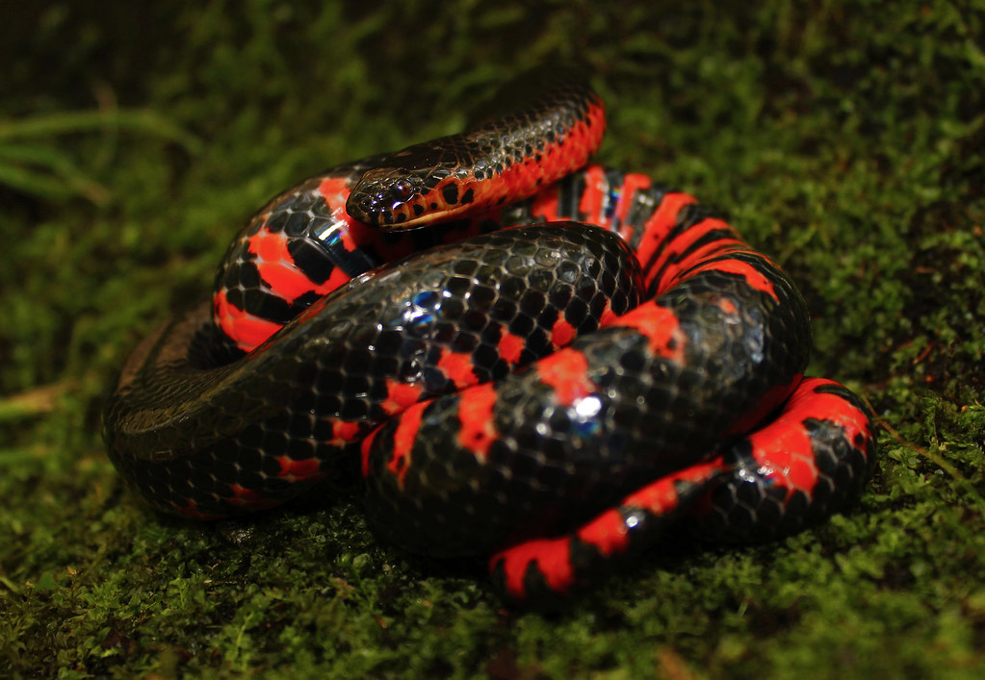

1. Focus on fundamental objectives and address conflicting objectives
Suggestions to identify alternatives
Creative Commons Licenses photos
Example: Rare Snakes
Problem/concern:
Many rare snakes are killed during capture
Objectives:
Minimize capture mortality
Maximize pet industry
Alternatives:
Status quo – do nothing
Ban sale of snakes
Others?
Potentially conflicting!!
Developed by Alex McInturff, Angela Matz, Mitch Eaton, Paul Barrett, Sarah J. Converse

Slide 12

2. Challenge constraints
Suggestions to identify alternatives
Tips:
Distinguish real and perceived constraints
Don’t anchor on initial set of options
Don’t evaluate – just develop
Give people time and permission to be creative
Developed by Alex McInturff, Angela Matz, Mitch Eaton, Paul Barrett, Sarah J. Converse

Slide 13
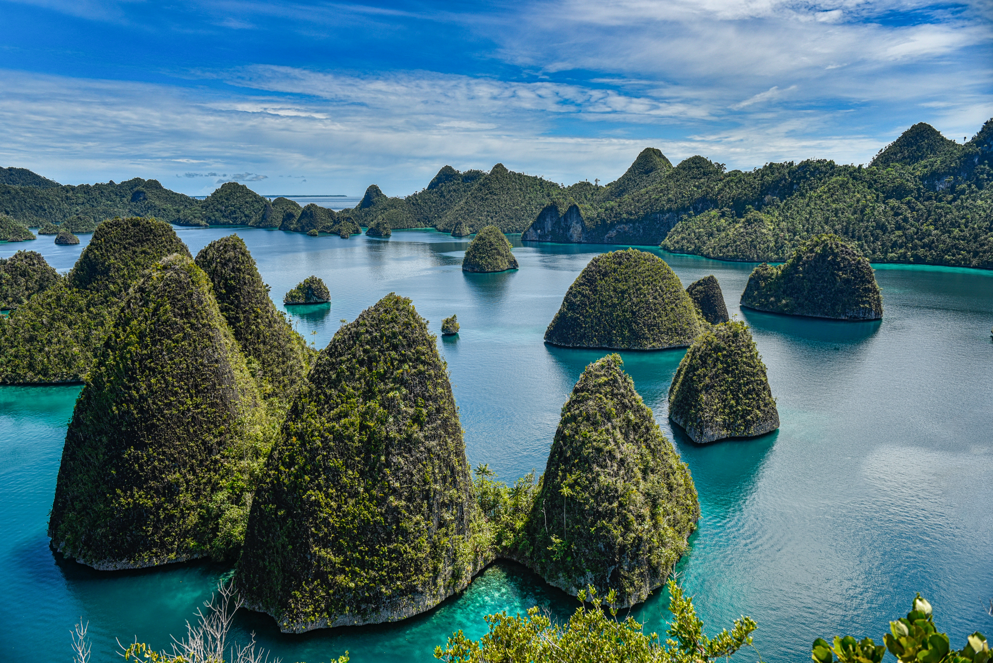

2. Challenge constraints
Suggestions to identify alternatives
Creative Commons Licenses photos
Activity – create alternatives despite constraints
Example: Bird translocation
Which of several islands should an endangered bird be translocated?
Perceived constraint: Introduced predators on Island A make it unsuitable
In groups: come up with 3 creative alternatives?
Developed by Alex McInturff, Angela Matz, Mitch Eaton, Paul Barrett, Sarah J. Converse
Notes:
Now lets think about challenging constraints with an example

Slide 14
3. Create groups of alternatives
Suggestions to identify alternatives
Groups of alternatives includes portfolios and strategies
JARGON ALLERT!!
Alternatives = general term for complete, comparable solutions to a decision problem
Actions = alternatives formed by individual options
Strategies and Portfolios = alternatives formed by combinations of actions
Developed by Alex McInturff, Angela Matz, Mitch Eaton, Paul Barrett, Sarah J. Converse

Slide 15
3a. Creating portfolios
Suggestions to identify alternatives
Portfolio: a combination of like elements arranged in a set
The elements themselves can be actions
e.g., set of research projects, funding allocation
The combination now represents a single alternative
e.g., stock portfolio
Constraints often limit number of possible portfolios
e.g., total budget for allocation across projects
Developed by Alex McInturff, Angela Matz, Mitch Eaton, Paul Barrett, Sarah J. Converse

Slide 16
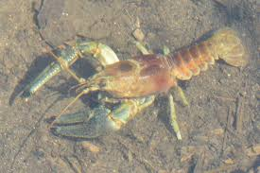
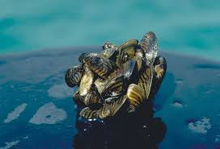
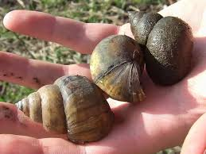
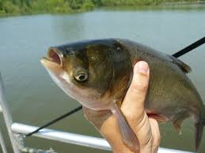
3a. Creating portfolios
Suggestions to identify alternatives
Example: portfolios for invasive species removal
Target species to remove
A
B
C
D
A + B
…
B+C+D
A+B+C+D
A
B
Portfolio 1
Portfolio 2
Portfolio 3
Portfolio Alternatives
Portfolio 4
C
D
Action 1 in Portfolio 5
Action 2 in Portfolio 5
Portfolio 5
Portfolio N-1
Portfolio N
Combination of like elements
Developed by Alex McInturff, Angela Matz, Mitch Eaton, Paul Barrett, Sarah J. Converse, Brielle Thompson

Slide 17
3b. Creating strategies
Suggestions to identify alternatives
Strategy: alternative combining multiple unlike elements:
Strategy table:
Group actions into themes (columns)
Create distinct strategies that represent different approaches or emphasize different objectives
Select the actions in each theme that fit each strategy
Combine selected elements into a strategy
Repeat steps 2-4 to create all strategies
Developed by Alex McInturff, Angela Matz, Mitch Eaton, Paul Barrett, Sarah J. Converse

Slide 18

3b. Creating strategies
Strategy table: Chipotle menu
Themes of ingredients: | Meat | Rice, Beans, and Veggies | Top It Off
 | None Steak Carnitas Chicken Barbacoa | Brown rice White rice Black beans Pinto beans Fajita veggies | None Salsa (Mild) Salsa (Hot) Sour cream Tomatillo Chili-Corn salsa Lettuce Guacamole Cheese
Developed by Alex McInturff, Angela Matz, Mitch Eaton, Paul Barrett, Sarah J. Converse

Slide 19
3b. Creating strategies
Strategy table: Chipotle menu
Themes of ingredients: | Meat | Rice, Beans, and Veggies | Top It Off
Strategies (aka burritos): “Brielle’s favorite” | None Steak Carnitas Chicken Barbacoa | Brown rice White rice Black beans Pinto beans Fajita veggies | None Salsa (Mild) Salsa (Hot) Sour cream Tomatillo Chili-Corn salsa Lettuce Guacamole Cheese
Developed by Alex McInturff, Angela Matz, Mitch Eaton, Paul Barrett, Sarah J. Converse

Slide 20
3b. Creating strategies
Strategy table: Chipotle menu
Themes of ingredients: | Meat | Rice, Beans, and Veggies | Top It Off
Strategies (aka burritos): “The Barnyard” | None Steak Carnitas Chicken Barbacoa | Brown rice White rice Black beans Pinto beans Fajita veggies | None Salsa (Mild) Salsa (Hot) Sour cream Tomatillo Chili-Corn salsa Lettuce Guacamole Cheese
Developed by Alex McInturff, Angela Matz, Mitch Eaton, Paul Barrett, Sarah J. Converse

Slide 21
3b. Creating strategies
Strategy table: Chipotle menu
Themes of ingredients: | Meat | Rice, Beans, and Veggies | Top It Off
Strategies (aka burritos): “The Veggie” | None Steak Carnitas Chicken Barbacoa | Brown rice White rice Black beans Pinto beans Fajita veggies | None Salsa (Mild) Salsa (Hot) Sour cream Tomatillo Chili-Corn salsa Lettuce Guacamole Cheese
Developed by Alex McInturff, Angela Matz, Mitch Eaton, Paul Barrett, Sarah J. Converse

Slide 22
3b. Creating strategies
Final strategy table: Chipotle menu
Themes→ ↓ Strategies | Meat | Rice, Beans, and Veggies | Top It Off
Brielle’s Favorite | Chicken | Brown rice, Black beans, Veggies | Salsa (mild), Chili-corn, Lettuce, Guacamole, Cheese
The Barnyard | Steak, Carnitas, Chicken | White rice, Pinto beans | Salsa (hot), Cheese
The Veggie | None | Brown rice, Black beans, Pinto beans, Veggies | Salsa (mild), sour cream Chili-corn, Lettuce, Guacamole, Cheese
Alternative Strategies
Meat action for the Barnyard strategy
Developed by Alex McInturff, Angela Matz, Mitch Eaton, Paul Barrett, Sarah J. Converse, Brielle Thompson

Slide 23
3b. Creating strategies
Example: Threatened species recovery
Themes: | Habitat Protection | Predator Control | Enhance Population | Alternative Economic Activity
 | Status Quo Ban logging in critical habitat Develop linkage corridors | Status Quo Harvest (5%) Increase harvest rate of predator to 10% Increase harvest rate of predator to 50% | None Maternity Pens Captive Breeding Translocate | None Promote sustainable harvest of species through lottery Promote non-consumptive recreation
Developed by Alex McInturff, Angela Matz, Mitch Eaton, Paul Barrett, Sarah J. Converse

Slide 24
3b. Creating strategies
Final strategy table for threatened species recovery,
Themes→ ↓ Strategies | Habitat Protection | Predator Control | Enhance Population | Alternative Economic Activity
Status Quo | Status Quo | Status Quo Harvest (5%) | None | None
“On the Go” (Dispersal) | Develop linkage corridors | Increase harvest rate of BNEG to 10% | Translocate | Promote non-consumptive recreation
Increase Pop to Carrying Cap | Ban logging in critical habitat | Increase harvest rate of BNEG to 50% | Captive Breeding | Promote non-consumptive recreation
Developed by Alex McInturff, Angela Matz, Mitch Eaton, Paul Barrett, Sarah J. Converse

Slide 25
Activity – create more strategies
Task: create 3 new strategies based on the following table
Example: Threatened species recovery
Themes: | Habitat Protection | Predator Control | Enhance Population | Alternative Economic Activity
 | Status Quo Ban logging in critical habitat Develop linkage corridors | Status Quo Harvest (5%) Increase harvest rate of predator to 10% Increase harvest rate of predator to 50% | None Maternity Pens Captive Breeding Translocate | None Promote sustainable harvest of species through lottery Promote non-consumptive recreation
Developed by Alex McInturff, Angela Matz, Mitch Eaton, Paul Barrett, Sarah J. Converse

Slide 26
Example: Humpback Chub (HBC) recovery in invasive trout waters (Runge et al. 2011)
----------------------------------------------THEMES----------------------------------------------
a) Trout management | b) HBC habitat | c) Recreation
1. None | 1. None | 1. No changes
2. 25 fish/acre killed | 2. Plant native vegetation | 2. Remove 50 boating days per year
3. 50 fish/acre killed | 3. Build sediment curtain | 3. Close wilderness areas for 1 year
4. 25 fish/acre removed via helicopter |  | 4. Prohibit boating for 1 year
5. 50 fish/acre removed via helicopter
Strategy table:
Strategy | A) Trout management | B) HBC habitat | C) Recreation
A (none) | a1 | b1 | c1
B | a2 | b2, b3 | c2
C | a3 | b2, b3 | c3
D | a4 | b2, b3 | c4
E | a5 | b2 | c3, c4
Adapted, modified, and simplified from Runge et al. 2011

Slide 27

4. Revisit objectives
Once you generate initial set of alternatives:
Be sure you’ve properly separated fundamental from means objectives
Identify if additional objectives exist
Developed by Alex McInturff, Angela Matz, Mitch Eaton, Paul Barrett, Sarah J. Converse

Slide 28
General tips:
SDM is iterative, don’t stop looking for alternatives
Create first, evaluate later
Consider alternatives that …
Are an ongoing process
Gather more information
Treat ‘unique’ alternatives as real and subject to the same evaluation as other alternatives
Developed by Alex McInturff, Angela Matz, Mitch Eaton, Paul Barrett, Sarah J. Converse

Slide 29


Skills Check Task 1 – Create Alternatives
Eagle reintroduction in Genovia
Consider this decision…
Decision maker: Refuge manager who is also interested in stakeholder’s perspectives & appeasing the royal crown
Trigger: Eagle population is nearly extinct in Genovia
Actions: Reintroduction, captive breeding, habitat management, etc
Constraints: Budget
Consideration: Nearby sport anglers (whose license sales fund conservation) like to fish on eagle prey
Frequency and Timing: One time decision
Scope: In two potential refuges in the kingdom (Refuge A or B)
Problem class: Multiple objective with uncertainty
Fundamental objectives:
Maximize eagle persistence
Minimize cost
Maximize angler satisfaction
Developed by Brielle Thompson
Notes:
Be sure to take good notes – we will build on this example throughout this module
I’ve already given you some brainstorming tips for creating good objectives.
I’ll hear back from a few of you on how you did in 5 minutes (give a little longer if needed).

Slide 30
Skills Check Task 1 – Create Alternatives
Task 1: Create Alternatives (use tables below as inspiration)
Add more!
Add these!
Themes: | Reintroduction
 | Status Quo (No reintroduction) Reintroduce 20 birds in Refuge A Reintroduce 20 birds in Refuge B Reintroduce 10 in Refuge A & 10 in B
Themes→ ↓ Strategies | Reintroduction
Create 4 strategies
Developed by Brielle Thompson
Notes:
Be sure to take good notes – we will build on this example throughout this module
I’ve already given you some brainstorming tips for creating good objectives.
I’ll hear back from a few of you on how you did in 5 minutes (give a little longer if needed).

Slide 32


The consequences step
Consequences link objectives and alternatives
Models (in SDM) are tools that help us predict consequences
Not always complex:
Will I make an 8:30 meeting if I leave home at 7:45?
The model is my experience
Or the model is Google maps
Developed by Sarah J. Converse

Slide 33

Simple example – set up
I need to arrange a flight
My objectives are:
Minimize price
Minimize flight duration
Minimize number of stops
Arrive before noon
Maximize quality of service
I need to make predictions about each of these objectives
Source of predictions:
Google flights: price, flight time, number of stops, and arrival time
TripAdvisor: airline service ratings
Developed by Sarah J. Converse

Slide 34
Simple example – consequence table
Objectives | Attribute | Desired Direction | Alternatives
 |  |  | 1 | 2 | 3
Price | Cost |  | $558 | $251 | $391
Flight time | Duration |  | 3h 40m | 5h | 5h 47m
 | Number of stops |  | nonstop | 1 | 1
Arrive before noon | Arrival time | threshold | 11:11am | 4:40pm | 10:57am
Service | Service rating: 1-5 (# of raters) |  | 2 (2121 raters) | 2 (233 raters) | 3 (1875 raters)
Developed by Sarah J. Converse

Slide 35
Simple example – consequence table
Objectives | Attribute | Desired Direction | Alternatives
 |  |  | 1 | 2 | 3
Price | Cost |  | $558 | $251 | $391
Flight time | Duration |  | 3h 40m | 5h | 5h 47m
 | Number of stops |  | nonstop | 1 | 1
Arrive before noon | Arrival time | threshold | 11:11am | 4:40pm | 10:57am
Service | Service rating: 1-5 (# of raters) |  | 2 (2121 raters) | 2 (233 raters) | 3 (1875 raters)
Developed by Sarah J. Converse

Slide 36
Some Principles of Modeling in SDM
Models should
Include ‘hard data’ (e.g., total cost) and subjective assessment (e.g., angler satisfaction) as appropriate
Make the most of available information, including expert judgment
Report appropriate level of precision
Incorporate relevant uncertainty
-Structural (broad model assumptions) e.g., density dependence?
- Parametric uncertainty e.g., what is the parameter’s distribution?
Developed by Sarah J. Converse

Slide 37
Influence Diagrams
Start with an influence diagram to develop a common understanding of the basic components of a model and the relationships between them
Influence diagram:
Directed Acyclic Graph (DAG)
Conceptually link the actions to objectives
Distinguish between relationships of the system
Begin with objectives and move towards alternatives
- Actions (rectangles)
- Stochastic factors (ovals)
- Intermediate factors (rounded rectangles)
- Objectives (hexagons)
Stochastic factor A
Action 1
Objective 1
Action 2
Intermediate factor B
Action 3
Objective 1
Intermediate factor B
Developed by Sarah J. Converse

Slide 38
Example: Crane Nest Failure
- Actions (rectangles)
- Stochastic factors (ovals)
- Intermediate factors (rounded rectangles)
- Objectives (hexagons)
Pre-Season Condition
Drawdown
Water Levels
Inverts
Aquatic Vegetation
Energetic Condition
Burning
Fertility
Min Mortality Rate
Mowing
Abandon-ment
Max Population Status
Suppl.
Feeding
Black Fly Harassment
Min Nest Failure Rate
Move Reintro. Site
Predation
Insecticide
Weather
Flooding
Developed by Sarah J. Converse

Slide 39
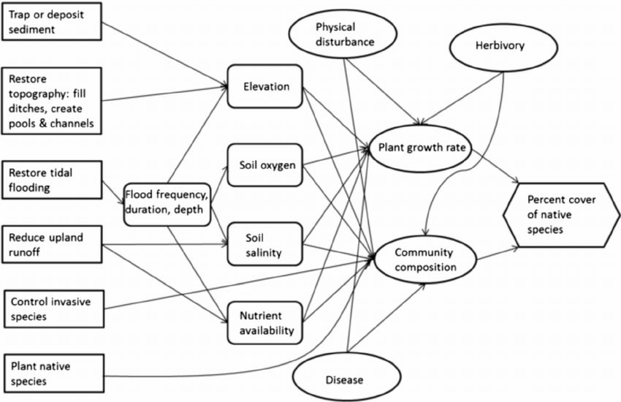
Example: Salt Marsh recovery
- Actions (rectangles)
- Stochastic factors (ovals)
- Intermediate factors (rounded rectangles)
- Objectives (hexagons)
Neckles et al. 2014
Developed by Brielle K Thompson

Slide 40
Example: Influence diagram
- Actions (rectangles)
- Stochastic factors (ovals)
- Intermediate factors (rounded rectangles)
- Objectives (hexagons)
Adapted, modified, and simplified from Runge et al. 2011
Maximize protection to tribal sacred sites and spiritual values
HBC disease
Water level
Weather
Trout disease
Minimize cost
HBC survival
HBC genetic diversity
Maximize recreation
Recreation
HBC fecundity
Aquatic vegetation
Maximize HBC population
HBC habitat
Trout survival
Trout removal
Minimize trout population
Trout fecundity

Slide 41
Skills Check Task 2
- Actions (rectangles)
- Stochastic factors (ovals)
- Intermediate factors (rounded rectangles)
- Objectives (hexagons)
Maximize eagle persistence
Minimize cost
Maximize angler satisfaction
Developed by Brielle Thompson
Notes:
Be sure to take good notes – we will build on this example throughout this module
I’ve already given you some brainstorming tips for creating good objectives.
I’ll hear back from a few of you on how you did in 5 minutes (give a little longer if needed).

Slide 42
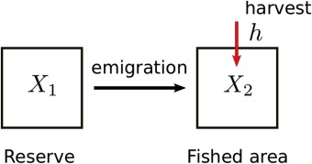
Modeling step
A variety of models can be used to generate consequences (i.e. results)
For example:
Population models (*most common)
Discrete time population models
Integrated population models
Occupancy models
Etc!
Statistical models
Empirical data
Expert opinion/ expert elicitation
Conduct rapid prototyping: start simple, adjust, and build up
da Silveira Costa & dos Anjos 2019
Developed by Sarah J. Converse and Brielle K Thompson

Slide 43

Examples of models:
Thompson et al. 2021
https://conbio.onlinelibrary.wiley.com/doi/full/10.1111/csp2.533

Slide 44
Consequence table
Consequence tables = A convenient way to display predictions for multi-objective decisions
Matrix of predictions by objective and alternative
Can give us an overall sense of our alternatives
Facilitates solving multi-objective decisions
 | Alternative 1 | Alternative 2 | … | Alternative n
Objective 1 | prediction | prediction |  | prediction
Objective 2 | prediction | prediction |  | prediction
…
Objective m | prediction | prediction |  | prediction
Developed by Sarah J. Converse

Slide 45
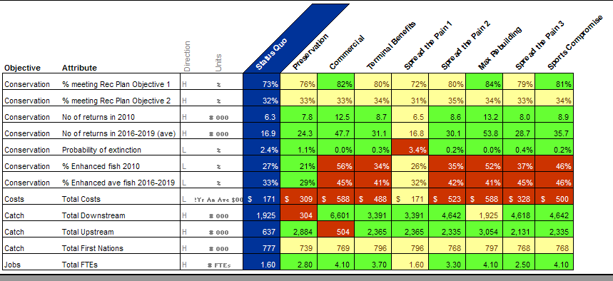
Example: consequence table
Gregory R and Long G. 2009. Using structured decision making to help implement a precautionary approach to endangered species management. Risk Analysis 29:518-532.
Developed by Sarah J. Converse
Notes:
Blue = status quo; Red = worse than status quo; Yellow = same as status quo; Green = better than status quo
Much of the information needed to evaluate the
six initial alternatives—the entries in the cells of
the consequence matrix—was not readily available.
The one-month time frame for the consultations
placed strong demands on the analysts and modelers,
and some typical methods for addressing severe
uncertainty—such as expert judgment elicitations(26)
or additional field studies—were simply not possible.
As a result, two primary tasks for the consultants
(in conjunction with DFO staff) between meetings 1
and 2 were (1) to determine whether additional alternatives
should be considered at this stage and (2)
to populate the matrix in order to help participants
begin to focus more clearly on a set of preferred alternatives.
This was done through interviews with managers,
through further development of existing simulation
models, and through the analysis of data from
similar case studies within the region or in the published
literature.
Gregory et al 2012
Presentation of consequences should convey all the information critical to understanding and comparing alternatives.
It needs to clarify the relative performance of each objective -- relative advantages and disadvantages -- in terms of the agreed upon objectives and performance measures.
Consequence table plays a key role in a deliberative process particularly for group decision making.
It's a visible collective agreement about how consequences will be represented for the purpose of the decision at hand.
The rows, agreement about what matters when choosing among alternatives
The cols, agreement about which alternatives merit considertion.
Each cell, a collective understanding of what is best available information.

Slide 46
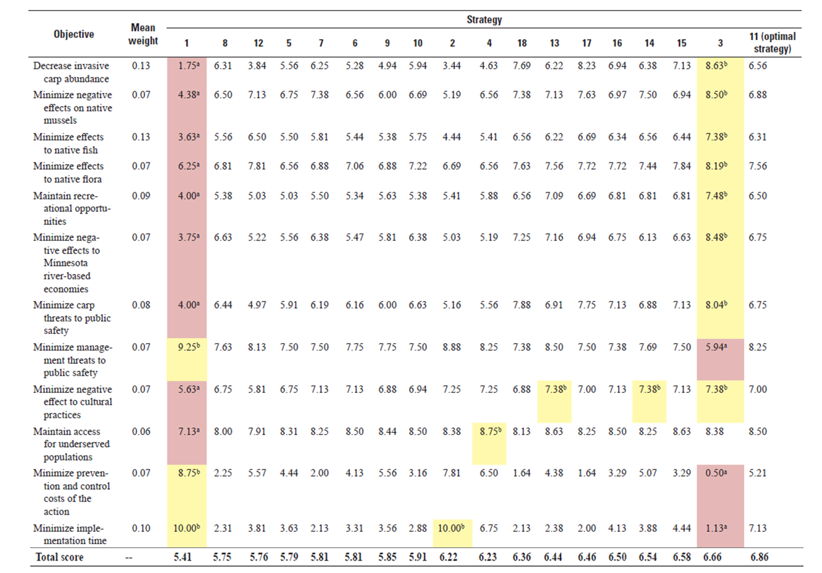
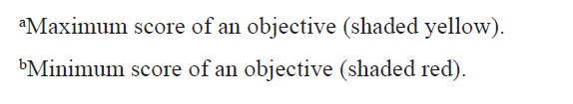
Example: consequence table Post van der Burg, M., and M. E. Colvin. 2024. Using structured decision making to assess management alternatives to inform the 2024 update of the Minnesota Invasive Carp Action Plan. Report 2024-1020, Reston, VA. https://pubs.usgs.gov/publication/ofr20241020
Developed by Mike Colvin

Slide 47
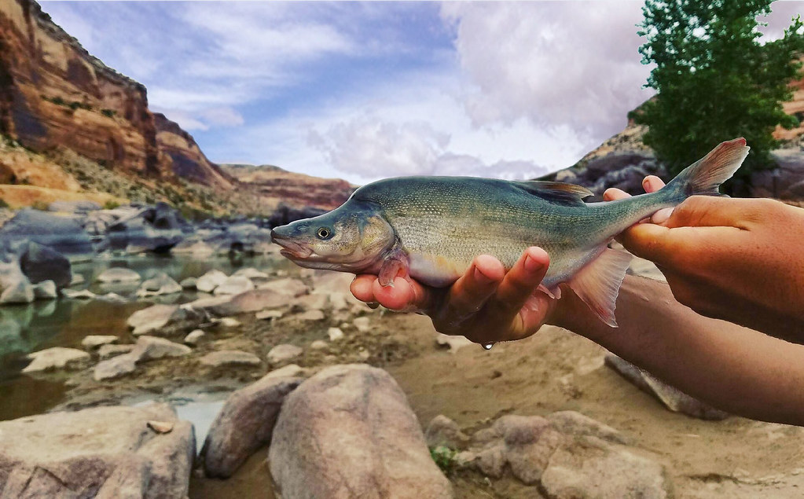
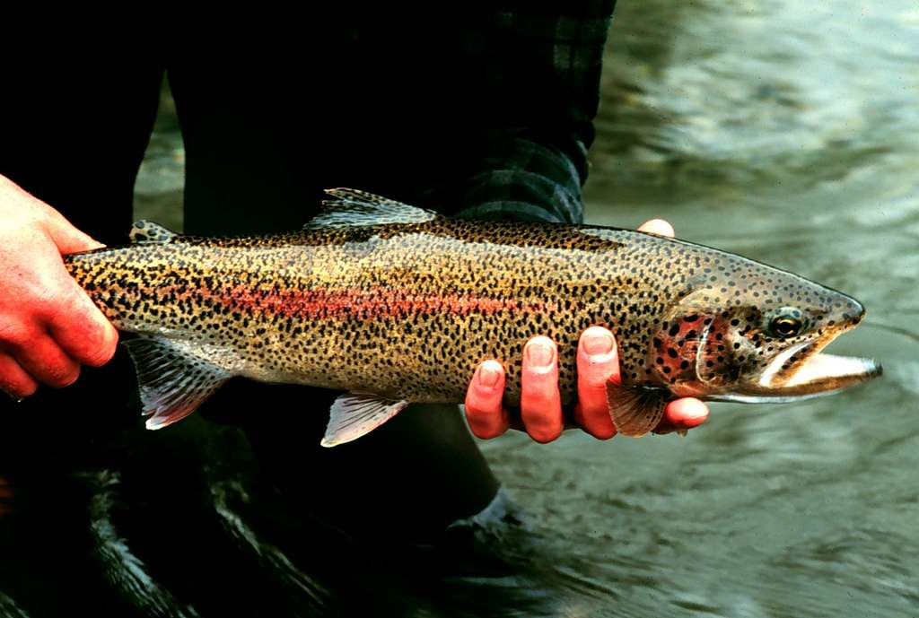
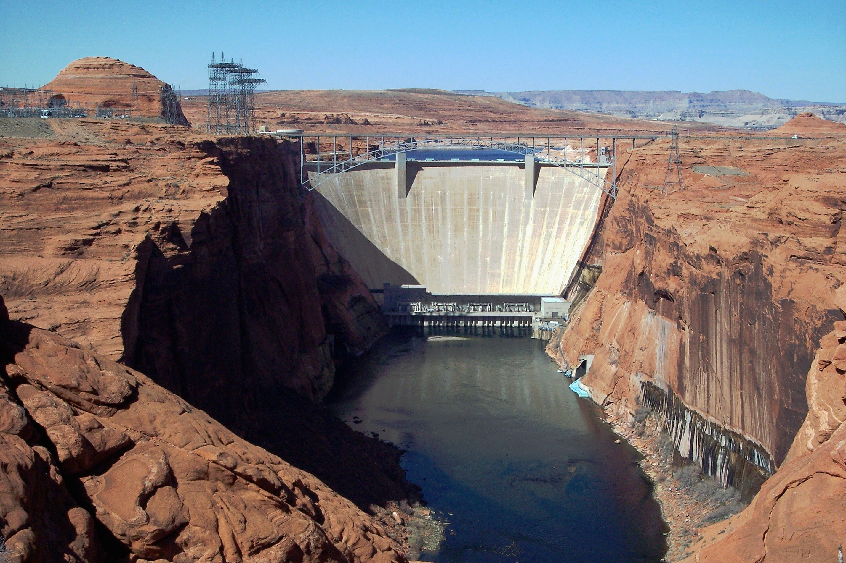
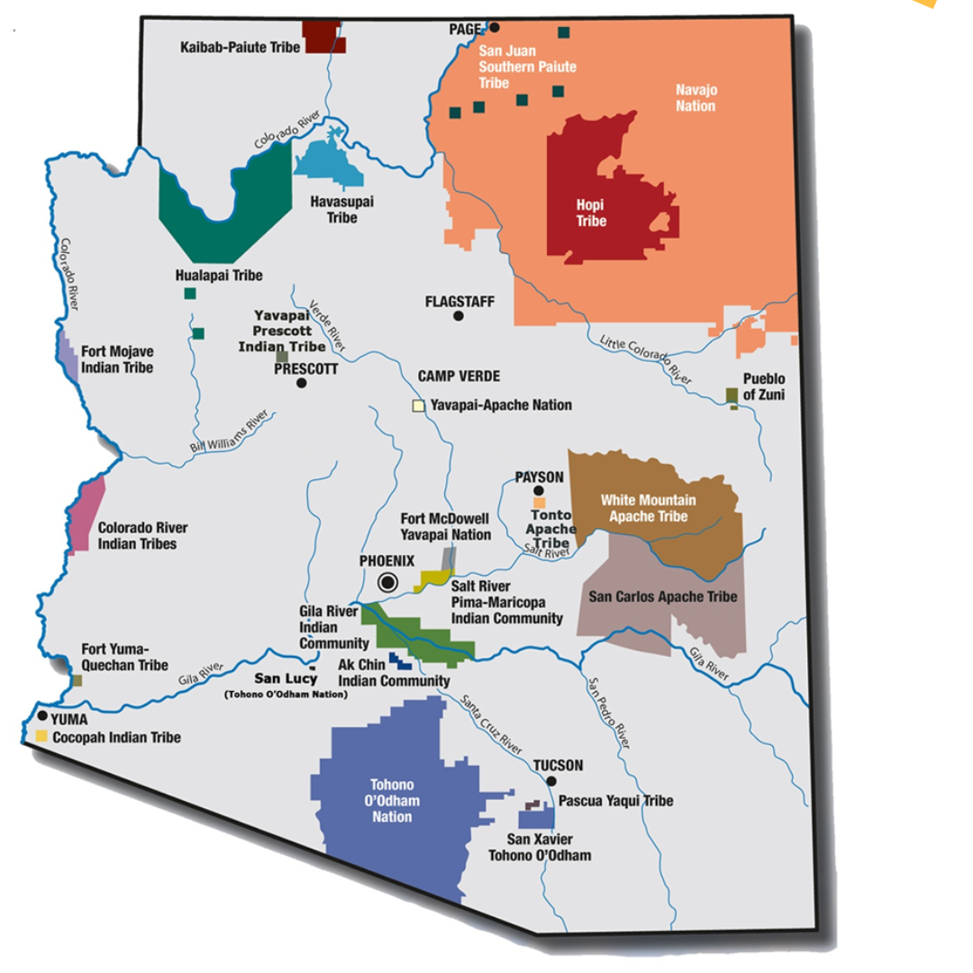
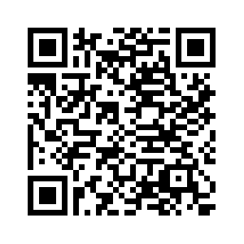
Models used in a Structured Decision: Example
SDM project: Non-native fish control below glen canyon dam to aid in humpback chub (HBC) recovery
Case study: (Runge et al. 2011)
Arizona Department of Education
Developed by Mike Runge

Slide 48
Models used in a Structured Decision: Example
OBJECTIVES
 | Alternative | Respect Life | HBC Recovery | Wilderness Disturbance | Cost
 |  | 0-10 scale | P(N>6000) | User-days | M$/5-yr
 |  | Max | Max | Min | Min
A | No action | 6.00 | 0.232 | 0 | 0
C₂ | LCR removal (lethal) | 6.33 | 0.343 | 5003 | 3.17
C₃ | LCR removal (mix) | 6.33 | 0.341 | 5037 | 3.53
C₄ | LCR removal (live, boat) | 9.67 | 0.341 | 5003 | 3.38
C₅ | LCR removal (live, heli) | 9.67 | 0.341 | 5154 | 4.65
D₁ | Removal curtain (lethal) | 8.00 | 0.532 | 6824 | 3.47
D₂ | Removal curtain (mix) | 6.33 | 0.532 | 6824 | 3.98
D₃ | Removal curtain (live) | 9.67 | 0.532 | 6867 | 4.36
J₁ | Kitchen Sink I | 1.67 | 0.555 | 6753 | 3.43
J₁’ | Kitchen Sink I w/ stock | 1.67 | 0.536 | 6777 | 3.62
J₂ | Kitchen Sink II | 1.67 | 0.555 | 6793 | 4.08
J₂’ | Kitchen Sink II w/ stock | 1.67 | 0.536 | 6818 | 4.32
K | Zuni-Hopi-NPS | 9.00 | 0.291 | 5400 | 3.03
Runge MC, Bean E, Smith DR, Kokos S. 2011. Non-native fish control below Glen Canyon Dam—report from a structured decision-making project. U.S. Geological Survey Open-File Report 2011-1012, 74 p.
Developed by Mike Runge

Slide 49
Models used in a Structured Decision: Example
Objective 1: Be respectful of non-human life
Reflects a value that taking life (rainbow trout, an invasive species) should be purposeful and done with good intent
Measurable attribute (constructed scale):
10-point constructed scale considers the relative degree of respectfulness for the proposed end uses of fish taken 0 = strong lack of respect for the lives of the fish taken 10 = strong respect for the lives of the fish taken
Model: expert elicitation
Representatives from three tribes scored the alternatives on this objective, integrating their cultural understanding
Runge MC, Bean E, Smith DR, Kokos S. 2011. Non-native fish control below Glen Canyon Dam—report from a structured decision-making project. U.S. Geological Survey Open-File Report 2011-1012, 74 p.
Developed by Mike Runge
Notes:
Note about expert elicitation: Don’t be persuaded that everyone should be involved in estimating consequences. In most every situation, there is a group of experts with specialized knowledge. (But let decision makers make select options).
“Four teams of experts were assembled to evaluate the consequences of the hybrid portfolios, a Cultural Objectives team, an Ecological Objectives team, a Recreational Objectives team, and a Public Service Objectives team. These teams reviewed the objectives, developed appropriate scales on which to measure achievement of those objectives (measurable attributes), and scored each hybrid portfolio against each of the measurable attributes. In some cases, the ―scoring was done through development of a quantitative model for predicting the outcomes associated with each alternative; in other cases, expert elicitation was employed to develop the scoring.” (Runge et al. 2011)

Slide 50
Models used in a Structured Decision: Example
Objective 2: Contribute to humpback chub recovery
Measurable attribute (natural scale):
Probability of the adult humpback chub population remaining above 6000 over the next 30 years
Model: Fish community dynamics
Dynamics modeled in the Colorado River (LCR) below Glen Canyon Dam with a Population Viability Analysis (three sub-models)
Lee’s Ferry (LF) Emigration Model
Trout Dynamics LF to LCR
LCR Humpback Chub Pop Dyn
Runge MC, Bean E, Smith DR, Kokos S. 2011. Non-native fish control below Glen Canyon Dam—report from a structured decision-making project. U.S. Geological Survey Open-File Report 2011-1012, 74 p.
Developed by Mike Runge
Notes:
Note about expert elicitation: Don’t be persuaded that everyone should be involved in estimating consequences. In most every situation, there is a group of experts with specialized knowledge. (But let decision makers make select options).
“Four teams of experts were assembled to evaluate the consequences of the hybrid portfolios, a Cultural Objectives team, an Ecological Objectives team, a Recreational Objectives team, and a Public Service Objectives team. These teams reviewed the objectives, developed appropriate scales on which to measure achievement of those objectives (measurable attributes), and scored each hybrid portfolio against each of the measurable attributes. In some cases, the ―scoring was done through development of a quantitative model for predicting the outcomes associated with each alternative; in other cases, expert elicitation was employed to develop the scoring.” (Runge et al. 2011)

Slide 51
Models used in a Structured Decision: Example
Objective 3: Minimize disturbance of wilderness experience as a result of non-native fish management in Grand Canyon NP wilderness
Measurable attribute (constructed scale):
Penalized user-days/year in the wilderness area during boat/helicopter trips for removal.
Staff size*number of days*penalty factors (for activities that result in greater disturbance)
Model: Nonnative fish population model
Included predictions of how many removal trips would be needed each year; multiply by the average staff size of a removal trip, the average length of a trip, and penalty factors
Runge MC, Bean E, Smith DR, Kokos S. 2011. Non-native fish control below Glen Canyon Dam—report from a structured decision-making project. U.S. Geological Survey Open-File Report 2011-1012, 74 p.
Developed by Mike Runge
Notes:
Note about expert elicitation: Don’t be persuaded that everyone should be involved in estimating consequences. In most every situation, there is a group of experts with specialized knowledge. (But let decision makers make select options).
“Four teams of experts were assembled to evaluate the consequences of the hybrid portfolios, a Cultural Objectives team, an Ecological Objectives team, a Recreational Objectives team, and a Public Service Objectives team. These teams reviewed the objectives, developed appropriate scales on which to measure achievement of those objectives (measurable attributes), and scored each hybrid portfolio against each of the measurable attributes. In some cases, the ―scoring was done through development of a quantitative model for predicting the outcomes associated with each alternative; in other cases, expert elicitation was employed to develop the scoring.” (Runge et al. 2011)

Slide 52
Skills Check Task 3
 |  | Alternative Strategies
Objective | Measurable attribute | Strategy 1: | Strategy 2: | Strategy 3: | Strategy 4:
Maximize eagle persistence | # of eagles after 1 year
Minimize cost | $
Maximize angler satisfaction | Constructed scale
Fill in the consequence table and score each outcome of each objective (it's okay to make up these numbers)
What type of models would you use to calculate each of the objectives. Is there another objective that comes to mind for this problem? How would you calculate that one?
Developed by Brielle Thompson
Notes:
Be sure to take good notes – we will build on this example throughout this module
I’ve already given you some brainstorming tips for creating good objectives.
I’ll hear back from a few of you on how you did in 5 minutes (give a little longer if needed).

Slide 53
Activity: think about your decision problem
For your final project presentation, you will provide a slide of your Alternatives
Can you generate alternatives?
Can you think of portfolios or strategies for your problem?
& You will provide a slide of your Consequences
Can you create an influence diagram?
Can you create a consequence table?
Don’t worry about filling it in with real #s
Feel free to go back to your problem framing & objective steps!
Developed by Brielle Thompson

Slide 54
Looking ahead:
Next week: T step of PrOACT
Weekly: Work through a step of the PrOACT process/ learn extra tools
Last week of class:
Elevator pitch of your research project in terms of SDM/PrOACT
Note: Abridged PrOACT story slides with a star on the upper right are good examples to use for your presentation
Developed by Brielle Thompson

Slide 55

Extra time activities:

Slide 56
Activity
Developed by: Alex McInturff, Angela Matz, Mitch Eaton, Paul Barrett, Sarah J. Converse
Impoundment Repair Problem
Decision maker: Refuge manager who is also interested in stakeholder’s perspectives
Trigger: Weir is not functioning adequately
Actions: Status quo, Minor or Major weir repair, Rebuild Impoundment
Constraints: Facilities funding available this year, not sure about future funding
Frequency and Timing: One time decision, but could be revisited in the future if funding is available
Scope: The impoundment and areas affected by the project
Problem class: Multiple objective with uncertainty

Slide 57
Activity
Developed by: Alex McInturff, Angela Matz, Mitch Eaton, Paul Barrett, Sarah J. Converse
Impoundment Repair Objectives
Objective | Direction | Performance measure
Cost | Minimize | Dollars ($M)
Environmental benefits | Maximize | Constructed scale (0 to 10)
Disturbance | Minimize | Constructed scale (0 to 10)
Silt runoff | Minimize | Thousand cubic feet (k ft³)
Water retention | Maximize | Million gallons (MG)

Slide 58
Activity
Developed by: Alex McInturff, Angela Matz, Mitch Eaton, Paul Barrett, Sarah J. Converse
Impoundment Repair Alternatives
What are the alternatives for this problem?
Are there additional alternatives? How would you develop them?

Slide 59
Activity
You are the manager of a National Wildlife Refuge and are in the process of deciding how to manage for an endangered lizard on the Refuge. The lizard seems to benefit from the disturbance associated with prescribed fire (though your budget for such activities is limited). Also, the species is susceptible to mortality on roads, but the Refuge receives substantial visitation by bird watchers, some of whom like to travel by car.
Given objectives:
Minimize probability of extinction of the lizard
Increase use of prescribed fire
Minimize costs
Minimize lizard road mortality
Maximize birder satisfaction
Maximize native bird species richness
Given alternatives:
Spatial/temporal variations of road closures and prescribed burns
Identify characteristics of the models we would want to build, including: Inputs, Outputs, Model types
Developed by Mike Runge, Sarah Covnerse
Notes:
Note about expert elicitation: Don’t be persuaded that everyone should be involved in estimating consequences. In most every situation, there is a group of experts with specialized knowledge. (But let decision makers make select options).
“Four teams of experts were assembled to evaluate the consequences of the hybrid portfolios, a Cultural Objectives team, an Ecological Objectives team, a Recreational Objectives team, and a Public Service Objectives team. These teams reviewed the objectives, developed appropriate scales on which to measure achievement of those objectives (measurable attributes), and scored each hybrid portfolio against each of the measurable attributes. In some cases, the ―scoring was done through development of a quantitative model for predicting the outcomes associated with each alternative; in other cases, expert elicitation was employed to develop the scoring.” (Runge et al. 2011)

Slide 60
Reading discussion- Gregory et al. 2017 ch7
What are the key characteristics of a “good” alternative in environmental decision-making?
How do strategy tables help in organizing and comparing alternatives?
What are some common pitfalls in generating alternatives, such as anchoring or premature screening?
How can we avoid these traps?

